Slide 1
UMD DATA605 - Big Data Systems Relational DBs
SQL Intro
SQL tutorial
Relational DB internals
Silbershatz: Chap 2

Slide 2
Overview
Introduced by Ted Codd (late 60's, early 70's)
Relational data model contributions
Separation of logical and physical data models (data independence)
Declarative query languages
Formal semantics
Query optimization (key to commercial success)
First prototypes:
Ingres -> CA
Postgres -> Illustra -> Informix -> IBM
System R -> Oracle, DB2

Slide 3
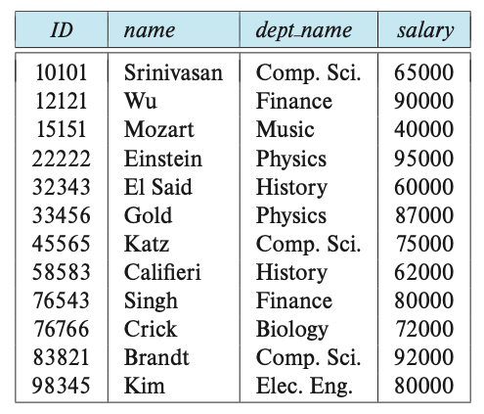
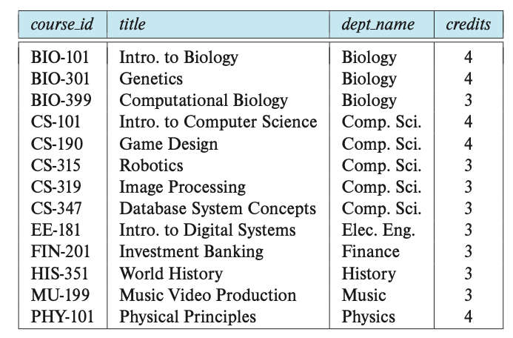
Relational model: key definitions
A relational DB consists of a collection of tables (aka relations)
Each table has a unique name and a schema
Each row (aka tuple, record) in a table represents a relationship among a set of values
Each element of the row corresponds to a column (aka attribute)
Each element is atomic (e.g., a phone number is a single object and not a sequence of numbers)
A valid value is `NULL` representing a value that is unknown or doesn’t exist (e.g., someone not having a phone number)
E.g., instructor and course relations
Relation schema
A list of attributes and their domains
Like type definition in programming languages
E.g., the domain of salary is integers >= 0
Relation instance
A particular instantiation of a relation with actual values
Will change over time
instructor relation
course relation
Notes:
Chap 2

Slide 4
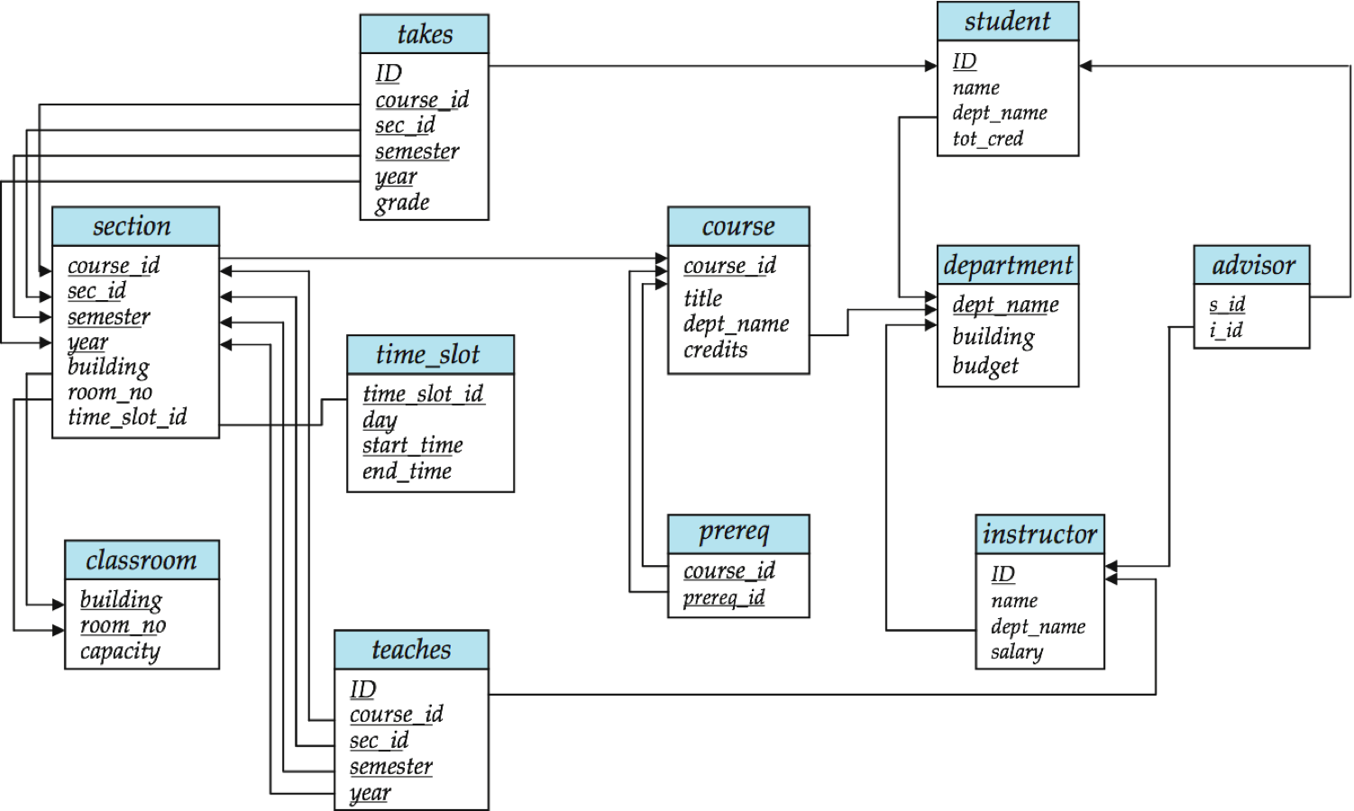
Example
Notes:
Schema diagram (schema + primary-key and foreign-key relation)
Each box is a relation with the name on top
The attributes are listed inside the box
Primary-key are underlined
Foreign-key relations are represented by arrows from (referencing to referenced relation)

Slide 5
UML class diagram
Unified Modeling Language
UML class diagram
Static structure diagram showing classes, attributes, methods, and relationships
Used in OOP and DB design
Schema diagram
Each box is a relation
Attributes are listed inside the box
Primary keys
Foreigh key constraints
Notes:
Chap 2

Slide 6
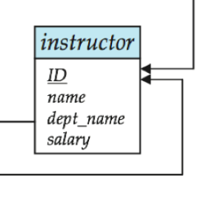
Primary Key
R is the set of attributes of a relation r
K is a superkey of R if values for K are sufficient to identify a unique tuple of each possible relation r(R)
E.g., {ID} and {ID,name} are both superkeys of instructor
{name} is not a superkey (or a key) of instructor
Superkey K is a candidate key if K is minimal
E.g., {ID} is a candidate key for instructor
One of the candidate keys is selected to be the primary key
Typically one that is small and immutable (doesn’t change often)
Primary keys typically are the first in the schema and highlighted / underlined
What the SSN be a primary key?
Primary key constraint: tuples in the relation can’t have the same primary key

Slide 7
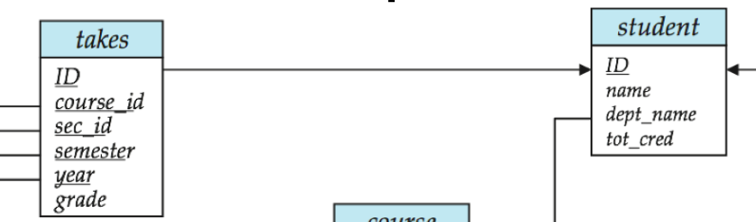
Foreign Key
Foreign key: primary key of a relation that appears in another relation
E.g., {ID} from student appears in takes, advisor
student called “referenced relation”
takes is the “referencing relation”
Typically shown by an arrow from referencing to referenced
Foreign key constraint: the tuple corresponding to that primary key must exist
E.g.,
Tuple: ('student101', ‘DATA605’) in takes
But no tuple corresponding to 'student101' in student
Aka referential integrity constraint

Slide 8
Relational algebra
Relation: set of tuples (without replication)
Relational algebra: set operations that take one or more relations as input and produce a new relation
E.g., select, project, rename (unary)
Union, Cartesian product, set difference (binary)
Selection: select tuples that satisfy a given predicate
E.g., select tuples of instructor where `dept_name = “Physics”
Projection: return tuples with a subset of attributes
E.g., project tuples of instructor with only ID, name, salary
Cartesian-product: combine information from two relations
E.g., `instructor` x `teaches`, where `instructor = (ID, name, dept_name)` and `teaches = (ID, course_id, sec_id, semester, year)` gives `(instructor.ID, name, dept_name, teaches.ID, ...)` or more verbosely `(instructor.ID, instructor.name, instructor.dept_name, teaches.ID, ...)`
Join: Cartesian-product and then a selection based on equality between two fields
E.g., instructor.ID = teaches.ID
Set operations: union, intersection, set-difference of relations
Need to be compatible (i.e., have the same attributes and names)
Assignment: assign parts of relational-algebra to temporary relation variables
A query can be written as a sequential program
Equivalent queries: two queries that give the same result on any DB instance
Some formulation can be more efficient than others

Slide 9
SQL Basics Overview
CREATE TABLE <name> ( <field> <domain>, ... ) INSERT INTO <name> (<field names>) VALUES (<field values>) DELETE FROM <name> WHERE <condition> UPDATE <name> SET <field name> = <value> WHERE <condition> SELECT <fields> FROM <name> WHERE <condition>

Slide 10
Keys: Examples
What are primary keys?
Married(person1-ssn, person2-ssn, date-married, date-divorced)
Account(cust-ssn, account-number, cust-name, balance, cust-address)
RA(student-id, project-id, supervisor-id, appt-time, appt-start-date, appt-end-date)
Person(Name, DOB, Born, Education, Religion, ...)
Information typically found on Wikipedia Pages
President(name, start-date, end-date, vice-president, preceded-by, succeeded-by)
Info listed on Wikipedia page summary
Rider(Name, Born, Team-name, Coach, Sponsor, Year)
Tour de France: Historical Rider Participation Information

Slide 11
SQL Overview
SQL
Originally called Sequel
Name was changed to Structured Query Language
Query data
Data definition language (DDL)
Define schema of the data (attributes, names, indices)
Specify integrity constraints
primary key
foreign key
not null
Data modification language (DML)
Modify the data in tables
Insert, update
Authorization
Specify security constraints
Define views
Control transactions (e.g., specify beginning and end, control isolation level)

Slide 12
Create table
CREATE TABLE r
(A_1 D_1,
A_2 D_2,
...
A_n D_n,
IntegrityConstraint_1,
IntegrityConstraint_n);
r is name of relation
A_i name of attribute
D_i domain of attribute A_i (optional constraints)
Primary key
need to be all non-null and unique
PRIMARY KEY (A_j1, A_j2, ..., A_jn)
Foreign key
FOREIGN KEY (A_k1, A_k2, ..., A_kn) REFERENCES s
Values of attributes for any tuple in a relation must correspond to values of the primary key attributes of some tuple in relation s
Not null
A_i D_i NOT NULL
Specify that null value is not allowed for that attribute
SQL will prevent changes to the DB that violate any integrity constraint

Slide 13
Select
SELECT A_1, A_2, ..., A_n
FROM r_1, r_2, ..., r_m
WHERE P;
SELECT: Select the attributes to list (projection)
FROM: list of relations to be accessed
WHERE: predicate involving attributes of the relations in the FROM clause
The FROM clause defines a Cartesian product of the relations
The query is going to be optimized to avoid to enumerate tuples that will be eliminated
In SELECT or WHERE clauses, we might need to use the table names as prefix to qualify the attribute name (e.g., instructor.ID vs teaches.ID)
Note how the SELECT statement can be expressed in terms of relational algebra (Cartesian product + selection + projection)
The only difference is that SQL allows duplicated values while relational algebra works with mathematical sets

Slide 14
Null values
An arithmetic operation with NULL yields NULL
Comparison with NULL
1 < NULL?
Then what about NOT(1 < NULL)?
SQL yields UNKNOWN when comparing with NULL value
There are 3 logical values: True, False, Unknown
Boolean operators
Can be extended according to common sense, e.g.,
True AND Unknown = Unknown
False AND Unknown = False
In a WHERE clause, if the result is Unknown it’s not included

Slide 15
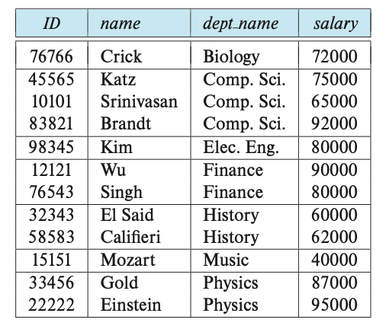
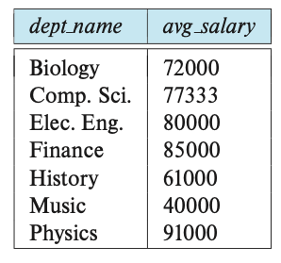
Group by query
The attributes in GROUP BY are used to form groups (i.e., tuples with the same value on all attributes are placed in one group)
Any attribute that is not in the GROUP BY can appear in the SELECT clause only as argument of aggregate function
SELECT dept_name, AVG(salary)
FROM instructor
GROUP BY dept_name;
-- Error.
SELECT dept_name, salary
FROM instructor
GROUP BY dept_name;
salary is not in GROUP BY so it must be in an aggregate function

Slide 16
Having
State a condition that applies to groups instead of tuples (like WHERE)
Any attribute in the HAVING clause must appear in the GROUP BY clause
E.g., find departments with avg salary of instructors > $42k
SELECT dept_name, AVG(salary) AS avg_salary
FROM instructor
GROUP BY dept_name
HAVING AVG(salary) > 42000;
How does it work
FROM is evaluated to create a relation
(optional) WHERE is used to filter
GROUP BY collects tuples into groups
(optional) HAVING is applied to each group and groups are filtered
SELECT generates tuples of the results, applying aggregate functions to get a single result for each group

Slide 17
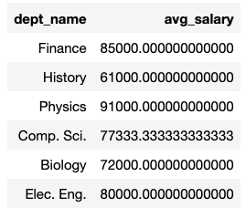
Nested subqueries
SQL allows to use the result of a query in another query
E.g., one can use a subquery returning only one attribute (aka scalar subquery) in any place a value is used
E.g., use the result of a query for set membership in the WHERE clause
E.g., use the result of a query in a FROM clause
SELECT tmp.dept_name, tmp.avg_salary
FROM (SELECT dept_name, AVG(salary) AS avg_salary
FROM instructor
GROUP BY dept_name) AS tmp
WHERE avg_salary > 42000

Slide 18

WITH
WITH clause allows to define a temporary relation containing the results of a subquery
It can be equivalent to a nested subqueries, but clearer
Find department with the maximum budget.
WITH max_budget(value) as (
SELECT MAX(budget) FROM department)
SELECT department.dept_name, budget
FROM department, max_budget
WHERE department.budget = max_budget.value

Slide 19
DELETE statement
One can delete using a query returning entire rows of a table
DELETE FROM r WHERE p
where r is a relation and P is a predicate
Remove all tuples but not the table
DELETE FROM instructor

Slide 20
INSERT statement
To insert data into a relation we can specify
tuples to insert
INSERT INTO course VALUES (‘DATA-605’, ‘Big data systems’, ‘Comp. Sci.’, 4)
INSERT INTO course(course_id, title, dept_name, credits) VALUES (‘DATA-605’, ‘Big data systems’, ‘Comp. Sci.’, 4)
query whose results is a set of tuples
INSERT INTO instructor (
SELECT ID, name, dept_name, 18000
FROM student
WHERE dept_name = ‘Music’ AND tot_cred > 144)
The query is evaluated and then inserted so this doesn’t create infinite workload
INSERT INTO student (SELECT * FROM student)
Many DB have bulk loader utilities to insert a large set of tuples into a relation, reading from formatted text files
This is much faster than INSERT statements

Slide 21
UPDATE statement
SQL can change a value in a tuple without changing all the other values
E.g., increase salary of all instructors by 5%
UPDATE instructor SET salary = salary * 1.05
E.g., conditionally
UPDATE instructor SET salary = salary * 1.05 WHERE salary < 70000
Nesting is allowed
UPDATE instructor
SET salary = salary * 1.05
WHERE salary < (SELECT AVG(salary) FROM instructor)

Slide 22
SQL Demo
http://localhost:8888/notebooks/data/02-Basics-SQL.ipynb
http://localhost:8888/notebooks/data/03-SQL-Different-Types-of-Joins.ipynb
http://localhost:8888/notebooks/data/04-SQL-NULLs-and-UNKNOWN.ipynb

Slide 23
Example Schema for SQL Queries
Movie(title, year, length, inColor, studioName, producerC#)
StarsIn(movieTitle, movieYear, starName)
MovieStar(name, address, gender, birthdate)
MovieExec(name, address, cert#, netWorth)
Studio(name, address, presC#)

Slide 24
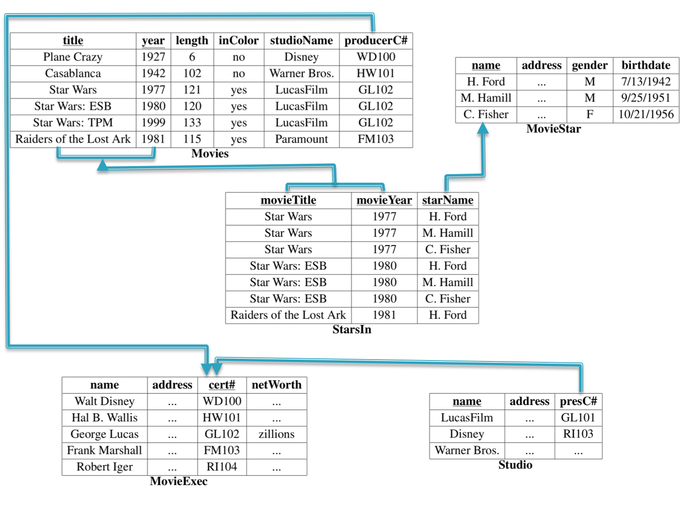
Notes:
Database Systems: The Complete Book
From http://infolab.stanford.edu/~junyang/cs145/RS5.html
http://infolab.stanford.edu/~ullman/dscbsols/sol7.html
https://www.cs.ubc.ca/~hkhosrav/db/slides/06.SQL.pdf

Slide 25
SQL: Data Definition
CREATE TABLE
Must define movieExec before movie. Why?
CREATE TABLE movieExec ( name char(30), address char(100), cert# integer primary key, networth integer); CREATE TABLE movie ( title char(100), year integer, length integer, inColor smallint, studioName char(20), producerC# integer references movieExec(cert#) );

Slide 26
SQL: Data Manipulation
INSERT
INSERT INTO StarsIn values('King Kong', 2005, 'Naomi Watts'); INSERT INTO StarsIn(starName, movieTitle, movieYear) values('Naomi Watts', 'King Kong', 2005);
DELETE
DELETE FROM movies WHERE movieYear < 1980;
Syntax is fine, but this command will be rejected. Why?
DELETE FROM movies WHERE length < (
SELECT avg(length) FROM movies);
Problem: as we delete tuples, the average length changes
Solution:
First, compute avg length and find all tuples to delete
Next, delete all tuples found above (without recomputing avg or retesting the tuples)

Slide 27
SQL: Data Manipulation
UPDATE
Increase all movieExec netWorth's over $100,000 by 6%, all other accounts receive 5%
Write two update statements:
UPDATE movieExec SET netWorth = netWorth * 1.06 WHERE netWorth > 100000; UPDATE movieExec SET netWorth = netWorth * 1.05 WHERE netWorth <= 100000;
The order is important
Can be done better using the case statement
UPDATE movieExec SET netWorth = CASE WHEN netWorth > 100000 THEN netWorth * 1.06 WHEN netWorth <= 100000 THEN netWorth * 1.05 END;

Slide 28
SQL Single Table Queries
Movies produced by Disney in 1990: note the rename
SELECT m.title, m.year FROM movie m WHERE m.studioname = 'disney' AND m.year = 1990;
The SELECT clause can contain expressions
SELECT title || ' (' || to_char(year) || ')' AS titleyear SELECT 2014 - year
The WHERE clause support a large number of different predicates and combinations thereof
year BETWEEN 1990 and 1995 title LIKE 'star wars%' title LIKE 'star wars _'

Slide 29
Single Table Queries
Find distinct movies sorted by title
SELECT DISTINCT title FROM movie WHERE studioname = 'disney' AND year = 1990 ORDER by title;
Average length of a movie
SELECT year, avg(length) FROM movie GROUP BY year;
GROUP BY: is a very important concept that shows up in many data processing platforms
What it does:
Partition the tuples by the group attributes (year in this case)
Do something (compute avg in this case) for each group
Number of resulting tuples == number of groups

Slide 30
Single Table Queries
Find movie with the maximum length
SELECT title, year FROM movie where movie.length = (select max(length) from movie);
The smaller "subquery" is called a "nested subquery”
Find movies with at most 5 stars: an example of a correlated subquery
SELECT * FROM movies m WHERE 5 >= (SELECT count(*) FROM starsIn si WHERE si.title = m.title AND si.year = m.year);
The "inner" subquery counts the number of actors for that movie.

Slide 31
Single Table Queries
Rank movies by their length
SELECT title, year, (SELECT count(*) FROM movies m2 WHERE m1.length <= m2.length) AS rank FROM movies m1;
Key insight: A movie is ranked 5th if there are exactly 4 movies with longer length.
Most database systems support some sort of a rank keyword for doing this
The above query doesn't work in presence of ties, etc.
Set operations
SELECT name FROM movieExec union/intersect/minus SELECT name FROM movieStar

Slide 32
Single Table Queries
Set Comparisons
SELECT * FROM movies WHERE year IN [1990, 1995, 2000]; SELECT * FROM movies WHERE year NOT IN ( SELECT EXTRACT(year from birthdate) FROM MovieStar );

Slide 33
Multi-table Queries
Key:
Do a join to get an appropriate table
Use the constructs for single-table queries
You will get used to doing all at once
Examples:
SELECT title, year, me.name AS producerName FROM movies m, movieexec me WHERE m.producerC# = me.cert#;

Slide 34
Multi-table Queries
Consider the query:
select title, year, producerC#, count(starName) from movies, starsIn where title = starsIn.movieTitle and year = starsIn.movieYear group by title, year, producerC#
What about movies with no stars?
Need to use outer joins
select title, year, producerC#, count(starName) from movies left outer join starsIn on title = starsIn.movieTitle and year = starsIn.movieYear group by title, year, producerC#
All tuples from 'movies' that have no matches in starsIn are included with NULLs
So if a tuple (m1, 1990) has no match in starsIn, we get (m1, 1990, NULL) in the result
The count(starName) works correctly then
Note: count(*) would not work correctly (NULLs can have unintuitive behavior)

Slide 35
Other SQL Constructs
Views
create view DisneyMovies select * from movie m where m.studioname = 'disney’;
Can use it in any place where a table name is used
Views are used quite extensively to: (1) simplify queries, (2) hide data (by giving users access only to specific views)
Views may be materialized or not

Slide 36
Other SQL Constructs
NULLs
Value of any attribute can be NULL
Because: value is unknown, or it is not applicable, or hidden, etc.
Can lead to counterintuitive behavior
For example, the following query does not return movies where length = NULL
select * from movies where length>= 120 or length<= 120
Aggregate operations can be especially tricky
Transactions
A transaction is a sequence of queries and update statements executed as a single unit
For example, transferring money from one account to another
Both the deduction from one account and credit to the other account should happen, or neither should
Triggers
A trigger is a statement that is executed automatically by the system as a side effect of a modification to the database

Slide 37
Other SQL Constructs
Integrity Constraints
Predicates on the database that must always hold
Key Constraints: Specifying something is a primary key or unique
CREATE TABLE customer ( ssn CHAR(9) PRIMARY KEY, cname CHAR(15), address CHAR(30), city CHAR(10), UNIQUE (cname, address, city));
Attribute constraints: Constraints on the values of attributes
bname char(15) not null
balance int not null, check (balance>= 0)

Slide 38
Integrity Constraints
Referential integrity: prevent dangling tuples
CREATE TABLE branch(
bname CHAR(15) PRIMARY KEY,
...); CREATE TABLE loan(...,
FOREIGN KEY bname REFERENCES branch);
Can tell the system what to do if a referenced tuple is being deleted

Slide 39
Integrity Constraints
Global Constraints
Single-table
CREATE TABLE branch (..., bcity CHAR(15), assets INT, CHECK (NOT(bcity = ‘Bkln’) OR assets>5M))
Multi-table
CREATE ASSERTION loan-constraint CHECK (NOT EXISTS ( SELECT* FROM loan AS L WHERE NOT EXISTS( SELECT* FROM borrower B, depositor D, account A WHERE B.cname = D.cname AND D.acct_no = A.acct_no AND L.lno= B.lno)))

Slide 40
Additional SQL Constructs
Select subquery factoring
To allow assigning a name to a subquery, then use its result by referencing that name
with temp as ( select title, avg(length) from movies group by year) select count(*) from temp;
Can have multiple subqueries (multiple with clauses)
Real advantage is when subquery needs to be referenced multiple times in main select
Helps with complex queries, both for readability and maybe performance (can cache subquery results)

Slide 41
Another SQL Construct
Select having clause
Used in combination with group by to restrict the groups of returned rows to only those where condition evaluates to true
select year, count(*) from movies where year > 1980 group by year having count(*) > 10;
Difference from where clause is that it applies to summarized group records, and where applies to individual records

